Slide 1
Linear Regression – Convexity of Error Function
Prof.N.L.Bhanu Murthy

Slide 2
Linear Regression

Slide 3
Linear Regression
Advertising (in lakhs of rupees) | Sales (in lakhs of rupees)
10 | 520
20 | 625
35 | 700
50 | 780
Predicting sales of an item

Slide 4
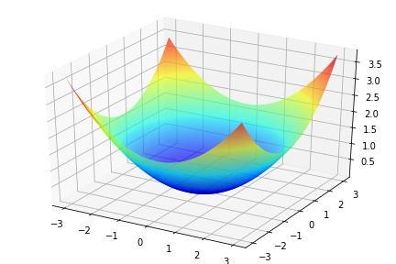
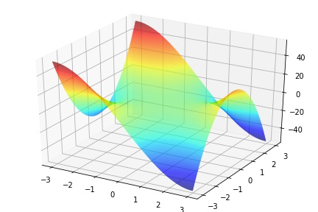
Linear Regression

Slide 5
Linear Regression

Slide 6
Linear Regression

Slide 7
Regression

Slide 8
Thank You!

